Slide 1
Social Interactionist Approach
By Mr. Nacer DEHDA

Slide 2
Social interactionism ascribes the
central role in the process of language acquisition to the environment.
The focus of attention of social
interactionists is the way interaction
leads to development of language
competence.

Slide 3
Major claim
Language, according to social
interactionists, develops through
interaction with other human
beings, which leads to input
modifications i.e. adjusting it to
the capacity of the learner.

Slide 4
Additionally, interactionists claim
no ‘critical period’ for language
acquisition exists as the process of
interaction is independent on
biological or cognitive development.

Slide 5
Social interactionists do not deny the
existence of neuropsychological
factors affecting language acquisition;
however, they claim that biological factors are not sufficient. They also do
not accept placing language as just one
more element of cognitive development.

Slide 6
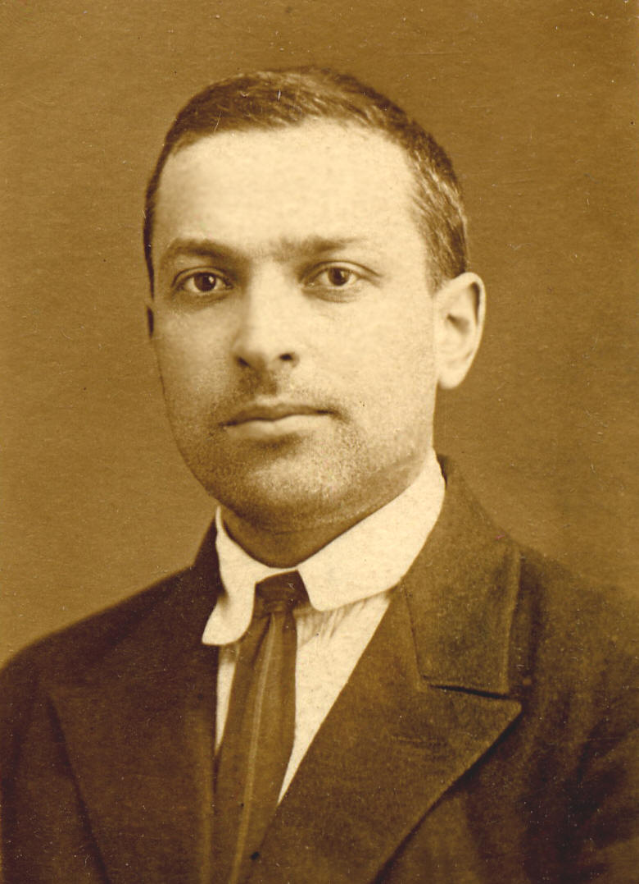
Lev Vygotsky
proposes the model of language acquisition consisting of two concepts:

Slide 7
01
Zone of proximal development
Level of skill or knowledge which is just
beyond what the learner currently copes with
02
Mediation
The role played by ‘significant people’, the people the
learner admires, who select and modify the learning
material for the learner helping her/him to move to the
next zone of proximal development

Slide 8
Consequently, the process of learning is not
the solitary experimenting and analysis of
the incoming information the learner is
exposed to, but the constant interaction
with the mediator, who modifies the input to make it fine tuned (adjusted) to the cognitive
and communicative needs of the learner.

Slide 9
A crucial role in the process of language
acquisition is played by the mediator
(parent, teacher, peer) and the modified
input. Bruner called this system LASS
(Language Acquisition Socialization
System) as opposed to Chomsky’s LAD.

Slide 10
THANK YOU!

