Slide 1
The Harlem Renaissance

Slide 2
“The Harlem Renaissance was an artistic and literary flowering movement that fostered a new black cultural identity in the 1920s and 1930s by a group of creative young writers, artists, musicians, and powerful social thinkers.”
“ a spiritual coming of age in which the black community was able to seize upon its first chances for group expression and self determination.”
“ It transformed social disillusionment to race pride”
Alain Locke

Slide 3
“I think . . . most Negroes were apt to agree that [the artistic output] was a good thing. . . . And such an achievement, because it was elite in character, was a source of race pride and an argument against continued discrimination.”
(Nathan Huggins : Harlem Renaissance]

Slide 4
What factors might have influenced the way African Americans felt about their situation in the United States at this time ?

Slide 5
The vast migration of African Americans to northern industrial centers that began early in the century and increased rapidly as World War I production needs and labor shortages boosted job opportunities.
The disappointment that African Americans felt with the limited opportunities open to them as the United States struggled to transform itself from a rural to an urban society.
Increased contact between African Americans and white Americans in the workplace and on city streets forced a new awareness of the disparity between the promise of U.S. democracy and its reality.
Soldiers and nurses who had gone abroad during World War I returned home angry and frustrated that white strangers in Europe treated them with greater equality than did white Americans.
Increasing numbers of young African Americans had become better educated and better informed since migrating to the North.

Slide 6
What are the economic, political, or social events that eventually lead to the Harlem Renaissance ?

Slide 7
Education in the south
"When I was a boy, the state didn't even give you but three months to go to school. That's all. Three months . . . you could barely learn the alphabet in three months.“

Slide 8
Jim Crow Laws

Slide 9
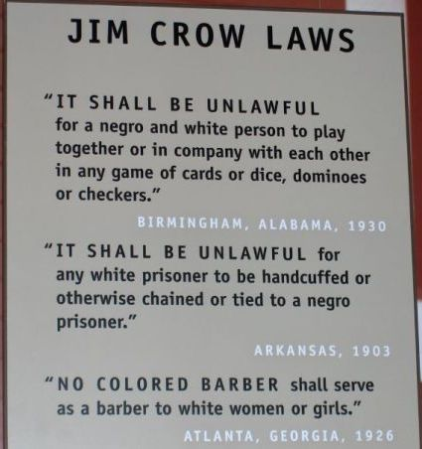

Slide 10
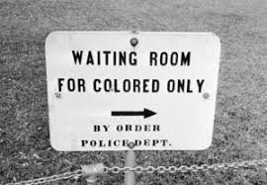

Slide 11
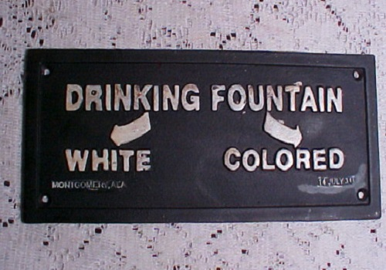
Drinking Fountains

Slide 13
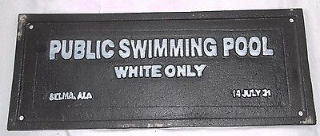

Slide 14
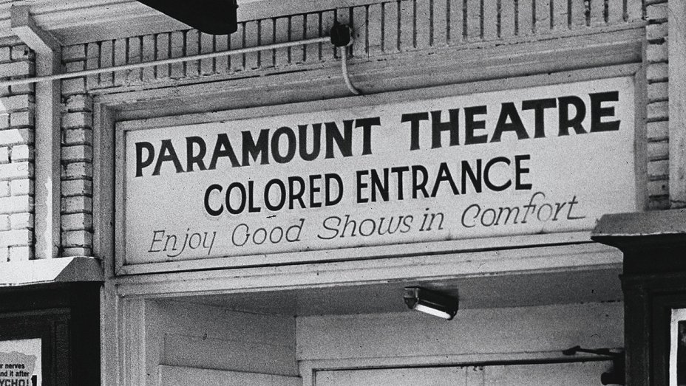

Slide 16
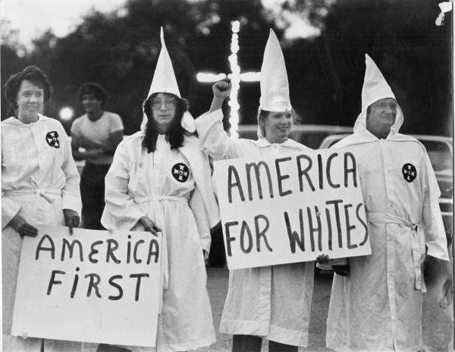
The Ku Klux Klan

Slide 17
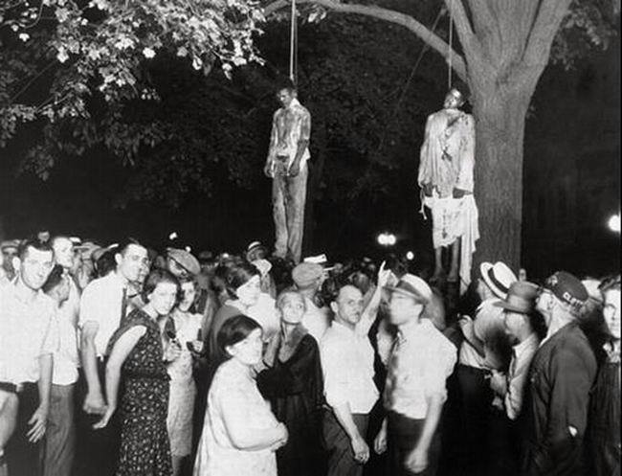

Slide 18
The most prolific figures of the Negro Movement

Slide 19
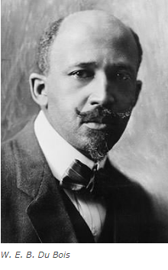
W.E.B Du Bois
In 1909, Du Bois co-founded the National Association for the Advancement of Colored People (NAACP), an organization which remains active even today. In 1910, the NAACP launched its official magazine The Crisis and Du Bois was its editor for the first 24 years. The Crisis played an important role in the Harlem Renaissance providing a platform for several well-known writers of the movement, including Claude McKay and Langston Hughes. Du Bois was among the leading intellectuals of the renaissance and wrote several important pieces which introduced concepts like ‘double consciousness’ which were widely used by writers of the movement.
- The Souls of Black Folk (Non Fiction Book, 1903)
- Dark Princess (Historical Novel, 1928)

Slide 20
“We have a right, in our effort to get just treatment, to insist that we produce something of the best in human character and that it is unfair to judge us by our criminals and prostitutes.”.
Du Bois. In Criteria for Negro Art. “The Crisis”, (1921)

Slide 21
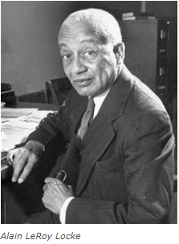
Alain Locke
Alain Locke was the editor of The New Negro: An Interpretation, which was published in 1925. An anthology of fiction, poetry, and essays on African and African-American art and literature. The New Negro is considered the definitive text of the Harlem Renaissance and gave it the name by which it was known during the time, the “New Negro Movement”. Along with W. E. B. Du Bois, Locke was the leading philosopher of the Harlem Renaissance and gave the movement direction and inspiration.

Slide 22
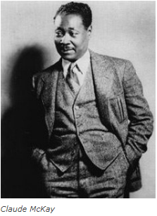
Claude McKay
A Jamaican immigrant who at first wrote poems primarily in Jamaican dialect but switched to Standard English forms after moving to the United States. His militant sonnet “If We Must Die” was published in 1919 during a period of intense racial violence. The poem noted for its revolutionary tone became popular among African American readers and is considered a landmark of Harlem Renaissance. His 1928 novel Home to Harlem became a best-seller and won the Harmon Gold Award for Literature. The following year his novel Banjo was published which was hailed as a radical work that envisioned the black political identity in a global framework. McKay was among the most famous writers of the Harlem Renaissance and an influential figure of the movement.
If We Must Die (Poem, 1919)
Home to Harlem (Novel, 1928)
Banjo (Novel, 1929)

Slide 23
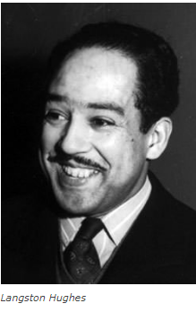
Langston Hughes
Langston Hughes is the most famous person associated with the Harlem Renaissance and among the most influential leaders of the movement. He famously wrote about the period that “the negro was in vogue”. Considered among the greatest poets in U.S. history, Hughes was one of the earliest innovators of jazz poetry, poetry that “demonstrates jazz-like rhythm”. His works often portrayed the lives of middle class African Americans. Hughes was a proponent of creating distinctive “Negro” art”.
The Weary Blues (Poetry Collection, 1926)
Fine Clothes to the Jew (Poetry Collection, 1927)
The Ways of White Folks (Short Stories Collection, 1934)
He stated : "Our Individual Dark-Skinned Selves"

Slide 24
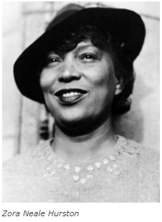
Zora Neale Hurston
A prominent figure of the movement. Her writings, more than anyone else, revealed the truth of the black Southern experience as being a native of the rural South she was intimate with black folklore. Hurston was the most prominent female writer of the Harlem Renaissance and her 1937 novel Their Eyes Were Watching God is considered among the most influential works of not only the Renaissance but also of African American and women’s literature

Slide 25
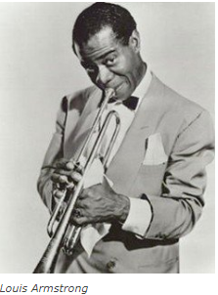
Louis Armstrong
In popular culture, Harlem Renaissance is famous for African American music which gained prominence during the movement, especially jazz. Rising to prominence in the 1920s. Louis Armstrong is not only the most popular musician of the movement but also considered among the greatest artists in jazz history. He first became known as an inventive trumpet and cornet player. And in the mid-1920s he emerged as the first great jazz soloist. Known for his unique voice Armstrong was also skilled at scat singing (vocalizing using sounds and syllables instead of actual lyrics). His contribution in the development and popularity of jazz music cannot be overstated.

Slide 26
Thank you

