Slide 1
Language and Linguistics
By Mr. Nacer DEHDA
http://www.free-powerpoint-templates-design.com

Slide 2
1. Language

Slide 3
1
Introduction

Slide 4
Language is relevant to many disciplines and activities: education, religion, anthropology, sociology, psychology, philosophy, history, literature, culture, politics, economics, science, etc. Language has also a bearing on our daily life. It is a common belief that language reflects human behaviour.

Slide 5
Lyons states that language is behaviour. Since language is a very complex phenomenon, and has multifarious aspects, any definition of it will be incomplete as this definition will inevitably depend on the angle from which language is looked at.

Slide 6
2
The origin of language

Slide 7
Anthropologists believe that if we knew when language first appeared, we would know when Man came into existence. They think that Man came into existence around one or two million years ago; however, the first writings go back to the Sumerians of 4000 B.C. Still, these figures provide no significant information as to the actual origin of Man and hence language.

Slide 8
In this regard, the linguist Robins states:
“Language as a human faculty is immeasurably older than the earliest attested languages (some 4000 years old), and writing is, compared with speech, very recent, the product of settled and developed civilization.”

Slide 9
In other words, the spoken form of language is older than the written form, for the latter has only recently been introduced by great civilizations. Furthermore, there are many languages which are still unwritten even nowadays.

Slide 10
In modern linguistics, linguists are interested in the origin of language; it is strongly believed that knowing the origin of language can help to understand the nature of human beings, and language acquisition, as language is the most important feature which distinguishes Man from animal.

Slide 11
1.1
The Divine Origin
of Language

Slide 12
It is believed by different religions that language was created by God. According to many religious beliefs and traditions all over the world, language has a divine origin. For Moslems, Allah provided Adam with the authority to name things.

Slide 13
In the Quran, it says: “God taught Adam all names”. For the Hindus, the human faculty of speech is a gift from a female God, Sarasvati, Brahma’s wife, the creator of the universe.

Slide 14
1.2
Language Adapted from
the Cries of Nature

Slide 15
In the mid eighteenth century, Jean-Jacques Rousseau thought that language stemmed from emotional cries pain, anger, joy, etc. He said that Man first used gestures and cries, but as both of these had no efficacy in communication, Man adapted the cries of nature to form words.

Slide 16
1.3
The Rationalist View
of Language Origin

Slide 17
The German philosopher Johann Herder believed that Man was born with a language and a faculty of thought, and that language was not invented by Man. His arguments are remarkably similar to those modern linguists like Chomsky who advocate that children acquire their native language without being taught any rules.

Slide 18
Herder believes that language faculty is innate, and that language is part of Man: it is neither given to him nor invented by him.

Slide 19
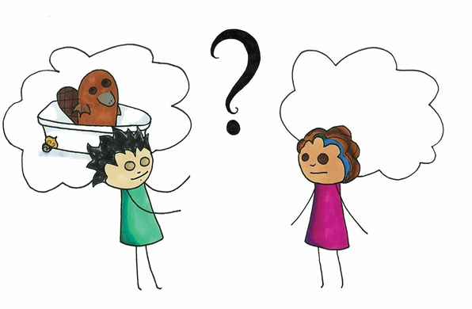
What is language?

Slide 20
Language touches every part of our lives: it gives words to our thoughts,
voice to our ideas, and expression to our feelings. It is a rich and varied human
ability—one that we can use effortlessly, that children seem to acquire
automatically, and that linguists have found to be complex yet systematic and describable.

Slide 21
Some Surprising but True Things about Language
You have been speaking one or more languages for most of your life, and therefore you may think that you know most of what there is to know about language. However, you will likely find some of the following facts about language surprising.

Slide 22
Grammar is actually a much more complex phenomenon than anything
(1) that could ever be taught in school, but nevertheless every human being masters the grammar of some language.
(2) There are languages that don’t have words for right and left but use words for
cardinal directions (like north and west) instead.
(3) Some aspects of language appear to be innate.
(4) There are more than 7,000 languages spoken in the world, but 90% of the population speaks only 10% of them.

Slide 23
(5) Some languages, such as Turkish, have special verb forms used for gossip and hearsay.
(6) Many of the sentences that you hear and utter are novel; they have never been uttered before.
(7) Some languages structure sentences by putting the object first and the subject
Last.
(8) No language is more or less logical than any other.

Slide 24
1.1.3 Some Common Misconceptions about Language
In addition to not knowing some of the facts in the list above, you may also have ideas
about language that are not true. The following is a list of common misconceptions. It’s
understandable that people might have come to hold some of these beliefs, because they are often propagated throughout societies (and a few of them even have an element of
truth to them); however, the scientific investigation of language has revealed them to be
false.

Slide 25
(1) People who say Nobody ain’t done nothin’ aren’t thinking logically.
(2) Swearing degrades a language.
(3) Many animals have languages that are much like human languages.
(4) Writing is more perfect than speech.
(5) The more time parents spend teaching their children a language, the better their
children will speak.

Slide 26
(6) You can almost always recognize someone’s background by the way he talks.
(7) The rules in grammar textbooks are guidelines for correct language use and should be followed whenever possible.
(8) Women tend to talk more than men.
(9) There are “primitive” languages that cannot express complex ideas effectively.
(10) People from the East Coast talk nasally.
(11) Some people can pick up a language in a couple of weeks.

Slide 27
What You Know
When You Know a Language

Slide 28
1. Linguistic Competence and Linguistic Performance
As a speaker of Arabic (or any other language that you may be a speaker of), you know a great deal about your language. Suppose, however, that someone were to ask you to put all of that knowledge into a textbook that would be used to teach Arabic to others.You would soon find that although you know perfectly well how to speak Arabic, you are not consciously aware of most of that knowledge.

Slide 29
If you think about it, we are really unaware of many of the things we do every day. For example, most people know how to walk and do so without thinking about it. Most of us can describe walking as well: we pick up one foot and put it in front of the other. However, there are many nuances and individual motor tasks involved in walking that we don’t ever think about and that only a very small set of people (kinesiologists, for example) understand:

Slide 30
exactly how you shift your balance between steps, how speed affects your stride, and so on. You modulate these things all the time when you walk without thinking about them, and very few people know exactly how they do so. The same holds true for our knowledge of language: for the most part, it is hidden. Linguists are interested in this “hidden” knowledge, which they refer to as linguistic competence.

Slide 31
Not all of your knowledge about language is hidden, however. People reveal some of their knowledge through their linguistic performance— the way that they produce and comprehend language. You can think of linguistic competence as a person’s unseen potential to speak a language, while linguistic performance is the observable realization of that potential: our performance is what we do with our linguistic competence.

Slide 32
Put another way, your linguistic competence is stored in your mind, and your linguistic performance is revealed in your speech (though keep in mind that revealing it does not mean that we are conscious of how it works).

Slide 33
Consider again the case of walking. If you are able to walk, you have the ability to do so even when you are sitting down (and not actively using it). That ability is your walking competence. When you stand up and walk across the room, that’s walking performance. Now, suppose that you stumble or trip on occasion. That doesn’t mean that you aren’t a competent walker: you still have your walking competence, but your performance was impaired.

Slide 34
Maybe you just weren’t paying attention to where you were going, or the ground was uneven, or it was dark and you couldn’t see clearly, or perhaps there was nothing unusual at all but for some reason you simply lost your balance. In the same way, you may make performance errors when you use language, such as being unable to remember a word, mispronouncing something, or jumbling the words in a sentence.

Slide 35
Sometimes there is an apparent reason: you may be tired or distracted, or you may be trying to produce a particularly difficult utterance.
Other times, however, there is no apparent reason at all: you simply make a mistake.Nonetheless, you still have your linguistic competence.

Slide 36
Since competence can’t be observed directly, linguists must use linguistic performance as a basis for making hypotheses and drawing conclusions about what linguistic competence must be like. However, in most cases they try to disregard imperfections in performance (the inevitable speech errors, incomplete utterances, and so on) and focus on consistent patterns in their study of linguistic competence.

Slide 37
2. The Speech Communication Chain
When you use language, you use it to communicate an idea from your mind to the mind of someone else. Of course, language is not the only way to do this; there are many types of communication systems, such as honking a horn on a car, drawing a picture, screaming wordlessly at the top of your lungs, or using semaphore flags. The key elements in any communication system (as outlined by Claude Shannon and Warren Weaver in 1949) are an information source, a transmitter, a signal, a receiver, and a destination.

Slide 38
When we use language as our communication system, one person acts as the information source and the transmitter, sending a signal to another person, who acts as a receiver and the destination. In order to act either as the source and transmitter or as a receiver and destination, you must know a lot about your language. The diagram in (1) outlines the communication chain as it relates to language.

Slide 39
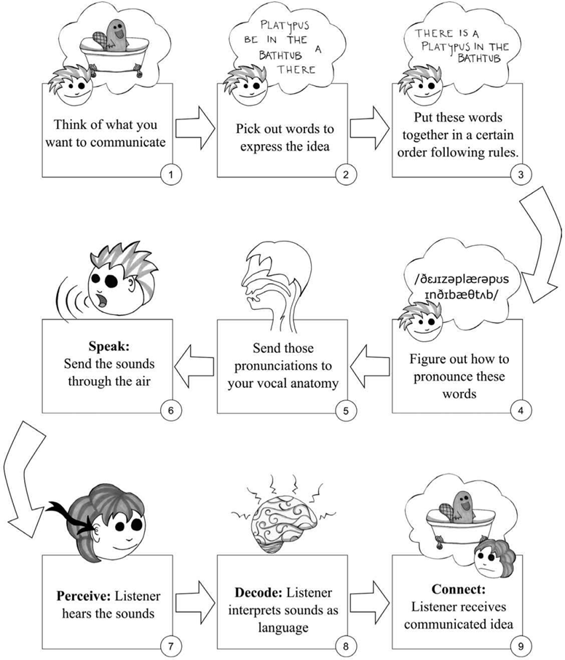
(1) The speech communication chain

Slide 40
This illustration shows the numerous steps that must be carried out in order for an idea to be communicated from one person to another. First, an idea of something to be communicated must be thought of. Once the idea is there, you have to put the idea into words that have the meaning you want to communicate and that are expressed in a particular way.

Slide 41
These steps form the backbone of much of traditional linguistic research. Note that these first four steps represent the “information source” in the communication system. Step 5 is the transmitter; in this step, the speaker actually gives physical expression to the idea of the message to be conveyed. Step 6 is the signal itself. Here, the sounds generated by the speaker travel through the air to the listener. The listener acts as the receiver in step 7, sensing the sound signal and sending it to her own brain.

Slide 42
Step 8 in the diagram is particularly simplified, in that it really encompasses steps 2–4 in reverse. That is, to “decode” the signal that has been perceived and to interpret the signal as language, the listener must understand and break down the order of words (and parts of words) and what the words mean. Finally, step 9 represents the destination: the listener has received the communicated idea.

Slide 43
LECTURE THREE

Slide 44
3. What You Know When You Know a Language
One of the most basic things that you know when you know a language, assuming that you use spoken language, is speech sounds. (If you use a signed language, you know a great deal about speech gestures in an analogous way.

Slide 45
First, you know which sounds are speech sounds and which sounds are not; if you hear a dog bark or a door slam, you will not confuse it with the sounds of language. You also know which speech sounds are sounds of your language as opposed to some other language.

Slide 46
Not only do you hear and recognize these sounds, but you also know how to produce them, even though you may have never had to think about the mechanics of doing so. Suppose you had to explain the differences between the vowels in the words fat, feat, and foot.

Slide 47
You have probably been producing these sounds for years without thinking twice about them, but clearly you do have competent knowledge of how to do so. All of this knowledge has to do with the area of language known as phonetics.

Slide 48
You have more knowledge than this about the sounds of your language, though: you also know how these sounds work together as a system. For instance, you know which sequences of sounds are possible in different positions.

Slide 49
In words like pterodactyl or Ptolemy, English speakers normally do not pronounce the /p/ because /pt/ is not a sound combination that can occur at the beginning of English words. There is nothing inherently difficult about the sequence; it occurs in the middle of many English words such as captive.

Slide 50
And in other languages, such as Greek, /pt/ appears at the beginning of words. This language-specific knowledge about the distribution of speech sounds is part of your phonology. Your knowledge of phonology allows you to identify that spaff and blig could be possible words of English but that fsap and libg could not.

Slide 51
Additionally, phonology allows you to recognize sounds and words spoken by different speakers, even though most people do not pronounce them in exactly the same way.

Slide 52
You also know how to break individual words down into smaller parts that have a particular meaning or function (how many parts are there in the word unbelievability?), and how to create words by combining these smaller parts.

Slide 53
That is, you can both produce and comprehend newly composed words that you haven’t heard before, for example, ungiraffelike. You also know which combinations are words and which ones aren’t: baker is a word, but*erbake is not.

Slide 54
Your knowledge of these and other facts about word formation comprises your knowledge of morphology.

Slide 55
You also know a great deal about your language’s syntax: how words combine to form phrases and sentences. This fact is evidenced by your ability to construct and use sentences that you have never heard before, and to recognize when a sentence is well-formed.

Slide 56
a. I will pick the package up at eight o’clock.
b. At eight o’clock, I will pick up the package.
c. * Package up pick at o’clock will the eight I.
d. * I will picks the package up at eight o’clock.

Slide 57
Another part of your linguistic competence has to do with your ability to determine the meaning of sentences. When you interpret meanings, you are appealing to your knowledge of semantics. When you hear a word, such as platypus or green or dawdle, you have some idea of a meaning that goes with that word.

Slide 58
You know when two words mean the same thing—e.g., sofa and couch—and when one word has two (or more) meanings—e.g., bank. You also know how words combine together to form larger meanings.
a. The green duck dawdled around the cactus.
b. The duck dawdled around the green cactus.

Slide 59
Your understanding of the meaning of sentences also involves an understanding of how the context of those utterances influences their meaning. Suppose that, while you are sitting in class, your instructor says to you, “Can you close the door?”

Slide 60
Taken quite literally, you have been asked a yes-no question about your door-closing abilities, but you would probably not even think of interpreting the question in that way; instead, you would understand it as a request to close the door. Your ability to use context in order to interpret an utterance’s meaning is part of your knowledge of pragmatics.

Slide 61
Your knowledge of pragmatics also helps you figure out which utterances are appropriate or inappropriate in any given situation.

Slide 62
Each of these elements of language—phonetics, phonology, morphology, syntax, semantics, and pragmatics—is part of your linguistic competence and is therefore an integral part of the way that you communicate linguistically. These are the things that you know when you say that you know a language.

Slide 63
What is LANGUAGE?

Slide 64
According to Sapir:” Language is a purely human and non-instinctive method of communicating ideas, emotions, and desires by means of voluntarily produced symbols”. This definition suffers from several defects.

Slide 65
However we broadly construe the terms ‘idea’, ‘emotion’ and ‘desire’, it seems clear that there is much that is communicated by language which is not covered by any of them; and ‘idea’ in particular is inherently imprecise.

Slide 66
On the other hand, there are many systems of voluntarily produced symbols that we only count as language in what we feel to be an extended or metaphorical sense of the word language. For example, what is now probably referred to by means of the expression ‘body language’- which makes use of gestures, postures, eye-gaze, etc.

Slide 67
Bloch and Trager wrote in their Outline of Linguistic Analysis:” A language is a system of arbitrary vocal symbols by means of which a social group co-operates”. What is striking about this definition, in contrast with Sapir’s, is that it makes no appeal, except indirectly and by implication, to the communicative function of language.

Slide 68
Instead, it puts emphasis upon its social function; and, in doing so, it takes a rather narrow view of the role that language plays in society. The Bloch and Trager definition differs from Sapir’s in that it brings in the property of arbitrariness and explicitly restricts language to spoken language.

Slide 69
In his Essay on Language, Hall tells us that language is “The institution whereby humans communicate and interact with each other by means of habitually used oral-auditory arbitrary symbols”

Slide 70
Among the points to notice here are:
The fact that both communication and interaction are introduced into the definition
01
The term ‘oral-auditory’ can be taken to be roughly equivalent to ‘vocal’, differing from it only in that ‘oral-auditory’ makes reference to the hearer as well as to the speaker (i.e. to the receiver as well as the sender of the vocal signals that we identify as language-utterances).
02

Slide 71
Design Features of Language
Defining language turns out to be a remarkably difficult task: nobody seems to be able to find a
definition of language that captures its fundamental
nature. But if we cannot define language, then we must
come up with some other solution because we still must have some way to identify language when we come across it.

Slide 72
One possibility is to identify the features that something must have in order to be a language. Linguist Charles Hockett designed one such list that identifies descriptive characteristics of language. While his list does not tell us the fundamental nature of language, it does tell us a great deal about what language is like and what we can do with it.

Slide 73
Hockett’s descriptive characteristics of language are known as the design features of language. The list has been modified over the years, but a standard version is provided below. While there are many
kinds of communication systems in the world, all of which follow
some form of the communication chain, only communication systems that display all nine of these design features can be called a “languag.

Slide 74
The order in which the design features are presented is also
significant: the features proceed from most universal to most
particular. All communication systems have the first three design
features, while human language alone has the final two.

Slide 75
1. Mode of Communication
The very nature of a system of communication is that messages must
be sent and received. The term mode of communication refers to the
means by which these messages are transmitted and received. For most human languages, speakers transmit messages using their voices;
however, a significant number of human languages are also transmitted gesturally—via hand, arm, head, and face movement. Both are viable
systems for transmitting the complex sorts of messages required of
language.

Slide 76
2. Semanticity
Another aspect of language that is universal across all
communication systems is semanticity. Semanticity is the
property requiring that all signals in a communication system have a meaning or a function. It is critically important to
successful linguistic communication that, for example, if your friend says to you “pizza,” you both have a similar idea of
what he is talking about.

Slide 77
3. Pragmatic Function
Communication systems must also have a pragmatic
function: that is, they must serve some useful purpose. Some
functions of human language include helping individuals to
stay alive, influencing others’ behavior, and finding out more about the world.

Slide 78
For example, a person who needs food might use language to ask for more mashed potatoes; more dramatically, a person trapped in a burning house might stay alive by calling for
help. A politician communicates certain messages to try to
influence people’s voting behavior. People ask questions in
order to learn the information they need to get through their days.

Slide 79
Sometimes people may question the usefulness of a certain
communicative act, for example, in the case of gossip.
However, even gossip fulfills a useful purpose in societies. It
helps us to understand our social environment and plays an
important role in social bonding and establishing social
relationships.

Slide 80
The same is true of set phrases such as “nice weather today” or the question, “Hey, what’s up?”And its typical response, “Not much. How about you?” These set phrases serve to
acknowledge the other person or initiate a conversation,
which are both necessary tasks for the maintenance of our
social structure.

Slide 81
4. Interchangeability
Interchangeability refers to the ability of individuals to
both transmit and receive messages. Each individual human can both produce messages (by speaking or signing) and
comprehend the messages of others (by listening or
watching).

Slide 82
5. Cultural Transmission
Another important feature of human language is that there
are aspects of language that we can acquire only through
communicative interaction with other users of the system.
This aspect of language is referred to as cultural transmission. Even though children’s ability to learn language seems to be
innate, they must still learn all of the specific signals of their
language through interaction with other speakers.

Slide 83
In fact, a child who is never spoken to will not learn
Language. Furthermore, children will learn the language(s)
or dialect(s) that other people use to interact with them. Thus, children of Russian parents will learn Russian if their
parents interact with them in Russian, but they will learn
English if their parents interact with them in English.

Slide 84
6. Arbitrariness
It is generally recognized that the words of a language
represent a connection between a group of sounds or signs, which give the word its form, and a meaning, which the form can be said to represent. The combination of a form and a meaning is called a linguistic sign: Form + Meaning =
Linguistic Sign.

Slide 85
An important fact about linguistic signs is that the
connection between form and meaning is typically
arbitrary. The term arbitrary here refers to the fact that
the meaning is not in any way predictable from the form, nor is the form dictated by the meaning.

Slide 86
The opposite of arbitrariness in this sense is nonarbitrariness, and there are some nonarbitrary aspects of language. The most
extreme examples of nonarbitrary form-meaning connections,
where the form represents the meaning directly, are said to be
iconic (or “picture-like”). For linguistic signs in general, however, the connection between form and meaning is not direct, nor is it derivable from laws of nature.

Slide 87
If there were an inherent, nonarbitrary connection between forms and meanings, with the meaning being determined by the form or vice versa, then such cross-linguistic differences should not occur. There would be universally recognized forms for each meaning.

Slide 88
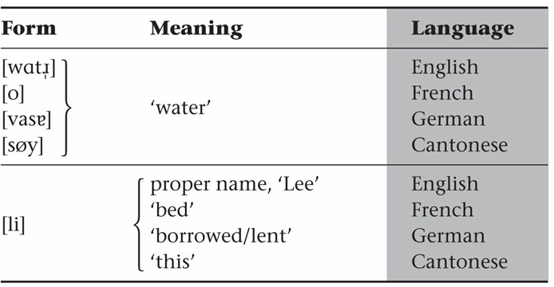

Slide 89
Finally, arbitrariness in language is shown in names for inventions and new products. For example, new cars come on the market
every year. Many of them are very similar to each other: they all
have four tires, a cabin that can seat some number of people, an
engine, and so on.

Slide 90
Yet despite their similarities, makes of cars have startlingly different names. Some of them are very long words while others are
quite short, and they begin with all kinds of different sounds.
A person naming a new car will certainly think of a sequence of
sounds that he likes, but he will not be constrained in any way
by the nature of the car or the nature of the sounds themselves—
only by her own arbitrary preferences.

Slide 91
Onomatopoeia: It is clear that arbitrariness is the norm in language, at least as far as the basic relationship between the form of a word and its meaning is concerned. At the same time, though, it turns out that there are some nonarbitrary aspects to language. In the vocabulary of all languages, there is a small degree of nonarbitrariness involving items whose forms are largely determined by their meanings.

Slide 92
Most notable and obvious are the so- called onomatopoetic
(or onomatopoeic) words, i.e., words that are imitative of natural
sounds or have meanings that are associated with such sounds of nature.

Slide 93
7. Discreteness
Consider the English sentence He is fast. It is not one unified
sign that always appears exactly as it is. Rather, it is composed of many discrete units. First, there are the independent words he, is, and fast. These words, in turn, are composed of even smaller
discrete units: the individual sounds [h], [i], [ɪ], [z], [f], [æ], [s],
and [t].

Slide 94
The property of language (among other communication systems)
that allows us to combine together discrete units in order to create larger communicative units is called discreteness.

Slide 95
Every language has a limited number of sounds, between roughly 10 and100. English, for example, has about 50 sounds. The sounds themselves are for the most part meaningless—the sound [f] in
fish or foot does not have any meaning by itself—but we can
combine a very small number of sounds to create a very large
number of meaningful words.

Slide 96
For example, we can combine the sounds [f], [u], and [l] to create the word fool; [t], [u], and [l] to create the word tool; [k], [u], and [l] to create the word cool, etc. We can then reorder the sounds in [kul] cool to get [klu] clue or [luk] Luke.

Slide 97
We can thus generate a large number of meaningful elements
(words) from a few meaningless units (sounds). We can further
combine words into phrases and sentences. Thus, from a
selection of only 100 or fewer units, we can create a very large
number of meanings (an infinite number, actually).

Slide 98
8. Displacement
Displacement is the ability of a language to communicate about
things, actions, and ideas that are not present in space or time
while speakers are communicating. We can, for example, talk
about the colour red when we are not actually seeing it, or we can talk about a friend who lives in another state when he is not with us.

Slide 99
We can talk about a class we had last year or the class we will take next year. We can also talk about things that do not exist, such as
unicorns and fictional characters.

Slide 100
9. Productivity
The last of Hockett’s design features is productivity, which is
closely related to discreteness. Productivity refers to a language’s capacity for novel messages to be built up out of discrete units.
Note how productivity differs from discreteness.

Slide 101
For a communication system to have discreteness, the only
requirement is that there be recombinable units; however, it
would be possible for there to be a fixed set of ways in which these units could combine. Indeed, some communication systems do work that way. Because language is productive, though, there is
no fixed set of ways in which units can combine.

Slide 102
The productivity of human language grants people the ability to
produce and understand any number of novel sentences that they have never heard before, thereby expressing propositions that
may never have been expressed before. In fact, in any language it is possible to produce an infinite number of sentences, so many
of the sentences that you hear are ones you have never heard
before.

Slide 103
For example, you probably have never read the following
sentence before, but you can still understand what it means:
Funky potato farmers dissolve glass. You understand what it
means even though you may not know why the potato farmers
are funky or how glass can be dissolved, and you know this even though you have never seen or heard the sentence before.

Slide 104
Rules at all levels of linguistic structure are productive. That is,
they allow creation of new forms, tell which new forms are allowed, and tell how they can be used. The rules of language, rather
than limiting us, are in fact what grant us the ability to
communicate about such a broad range of ideas.

Slide 105
THANK YOU !!

