Slide 1
Linguistics
By Mr. Nacer DEHDA

Slide 3
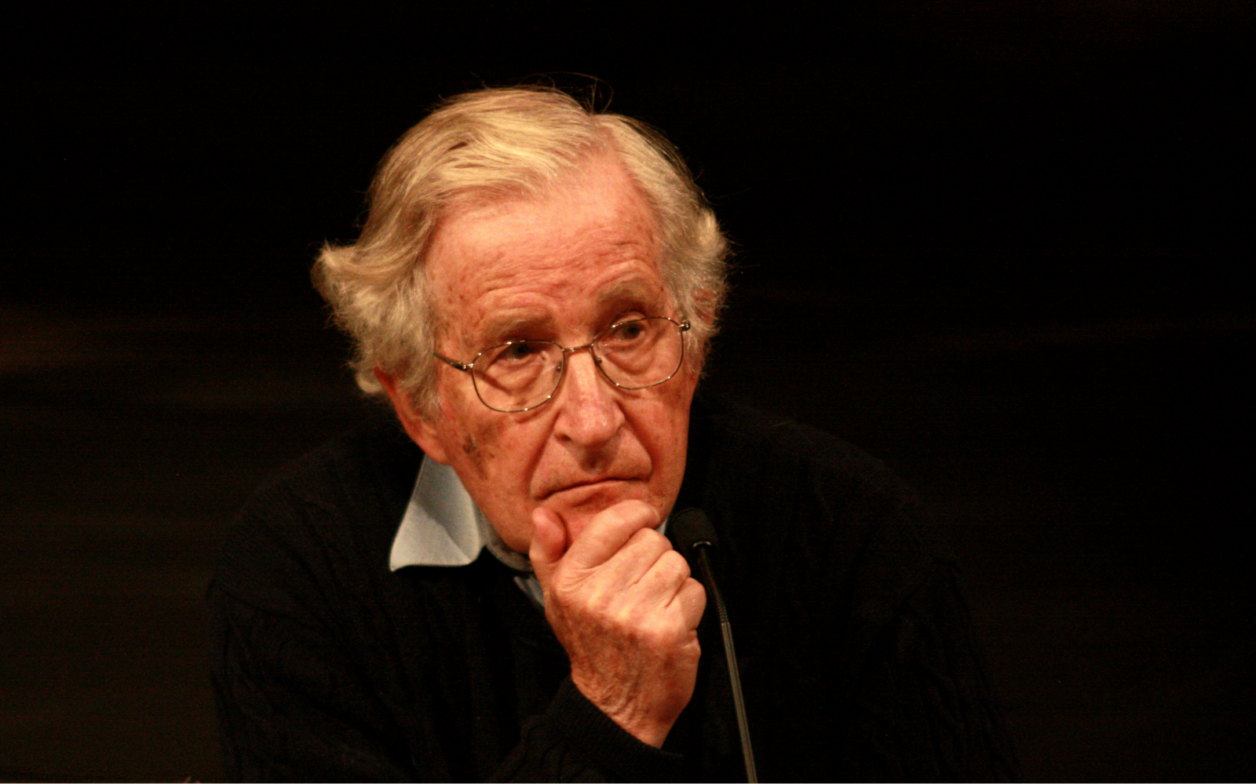

Slide 4
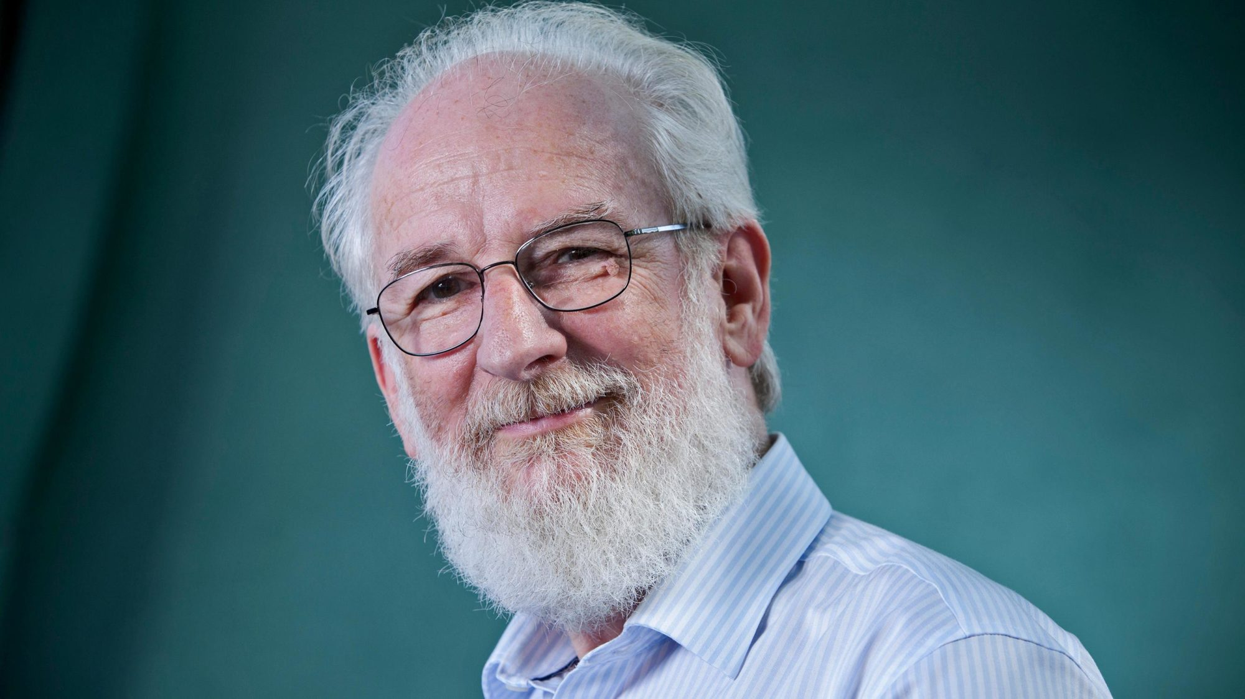

Slide 5
Linguistics is referred to as the science of language. It is concerned with the study of human language in all its aspects and manifestation.

Slide 6
Its scientificity is unquestionable since it relies on the canons of the scientific method, namely objectivity, exhaustiveness, consistency and economy. It is different from traditional grammar mainly because it takes spoken language to be its primary subject matter.

Slide 7
Definition of linguistics

Slide 8
Linguistics has two majors:
1/ bringing our unconscious knowledge of language to the level of consciousness by familiarizing us with this linguistic knowledge.
1
2/ studying how the different units of language are combined and how they operate in human brain.
2

Slide 9
In general, linguistics is defined as the scientific study of language. Such a definition touches on the relationship between linguistics and other disciplines, namely psychology, sociology and philosophy, because language is linked to the study of the brain, society, thought, culture and knowledge of the world.

Slide 10
Linguistics deals with language as one of the most intricate and important traits of Man. It studies language as a universal part of human behaviour and human faculties. Linguistics is not concerned with a specific language as its subject matter, but with human language in general.

Slide 11
In other words, linguistics as a new science, deals with all the languages of the world, estimated at about 3000; consequently, any language can be the subject matter of linguistics.

Slide 12
It is not possible for a linguist to know about, let alone speak, all human languages. A linguist, then, should be distinguished from a polyglot, for he does not necessarily have to master many foreign languages; however, it is preferable that a linguist know about a number of languages.

Slide 13
David Crystal states that (…) it is not a question of ‘speaking’ a language which makes a man a linguist, but of being able to ‘speak about’ a language, of knowing about the principles on which languages can be said to work, and about the kinds of difference which exist between one language and another.

Slide 14
Linguistics is guided by the three canons of science:
Exhaustiveness
1
It strives for thorough-goingness in the examination of relevant materials.
Consistency
2
That is, there should be no contradiction between different parts of the total statement
Economy
3
Other things being equal, a shorter statement or analysis is to be preferred to one that is longer or more complex.

Slide 15
The difference
between traditional
grammar and modern
linguistics

Slide 16
The difference between traditional grammar and modern linguistics
Traditional grammar
1. Written language as primary
2. More emphasis on grammar
3. Prescriptive
4. Force languages into a Latin-based framework
Modern linguistics
1. Spoken language as primary
2. Deals with all aspects of language: sounds, structure and meaning.
3. Descriptive
4. Don’t judge one language by standards of another.

Slide 17
Thank you!

