Slide 1
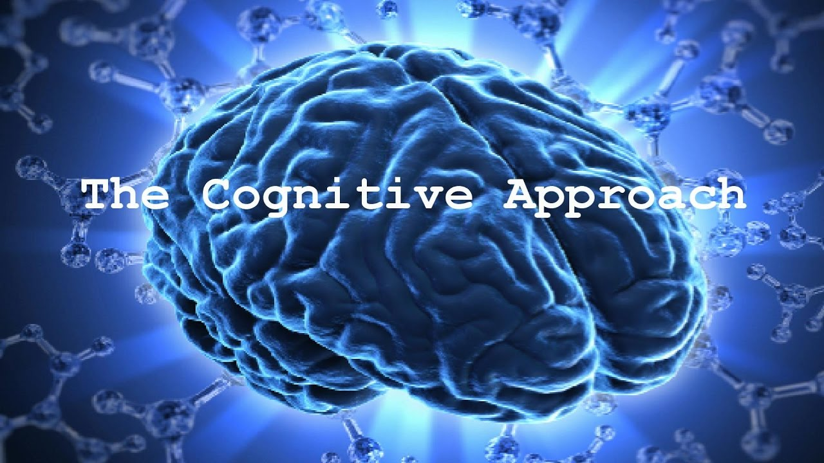
By Mr. Nacer DEHDA

Slide 2
Major claim:
Language is a part of cognitive development. To be able to learn a new word a learner has to understand a concept the word represents. Language learning is viewed as a mental process.

Slide 3
It is disputable whether linguistic development depends on cognitive development; however, it is undisputable that there is a strong correlation between the two processes.

Slide 4
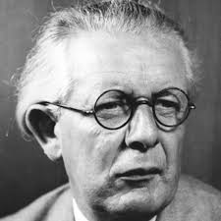
Piaget believed that language is just one aspect of human cognition.

Slide 5
Cognitive development means experimenting with the environment and constructing one’s personal meaning of it. By touching different objects we develop the tactile understanding of our environment, we construct the system in which steel is cold, wood is hard, and silk is soft.

Slide 6
It is the same thing with language: through experimenting with different words, word combinations and their different uses, we establish our language system.

Slide 7
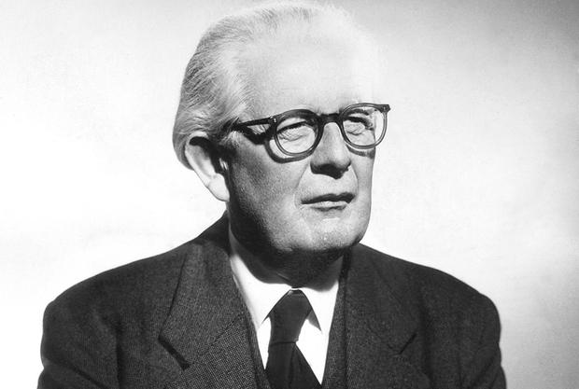
Piaget saw the process of human development from childhood to adulthood as consisting of five stages, assuming that language development should comply with these stages.

Slide 8
Exploring the world through basic senses.
1
Sensori-motor stage:

Slide 9
Forming pre-concepts on the basis of particular instances.
2
Pre-conceptual stage:

Slide 10
Memory and imagination start to play role, actions begin to be internalised.
3
Intuitive stage:

Slide 11
Ability to draw conclusions, analyse, but only on concrete level.
4
Concrete-operational stage:

Slide 12
Abstract reasoning becomes possible.
5
Formal-operational stage:

Slide 13
Cognitive theory promotes the constructive nature of the learning process: not the accumulation of facts, but constructing personal meaning from experience

Slide 14
Development is believed to rely on two processes:
1. Assimilation (modifying incoming information to fit our knowledge)
2. Accommodation (modifying our knowledge to include new information)

Slide 15
These two processes are essential for any form of learning and also apply in language learning, coming across a new language form, we tend to assimilate it, to understand as much as possible on the basis of our internalised linguistic knowledge.

Slide 16
later, when we have understood the message and start analysing and experimenting with the newly observed language rule, we modify our previous linguistic repertoire so as to incorporate the new language principle.

Slide 17
Thank you for your attention

