Slide 1
Language acquisition
Dr. Nour toumi

Slide 2
Outline
Defining language acquisition
Stages of language acquisition
Theories of language acquisition
Behaviourist theory
Chomsky critique to behaviourism
Nativist Theory
Criticism of Nativism
Interactionist theory
Limitations of interactionism

Slide 3
“Language acquisition seems much like the growth of organs generally; it is something that happens to a child, not a child does. And while the environment plainly matters, the general course of development and the basic features of what emerges are predetermined by the initial state, a common human possession” Noam Chomsky

Slide 4
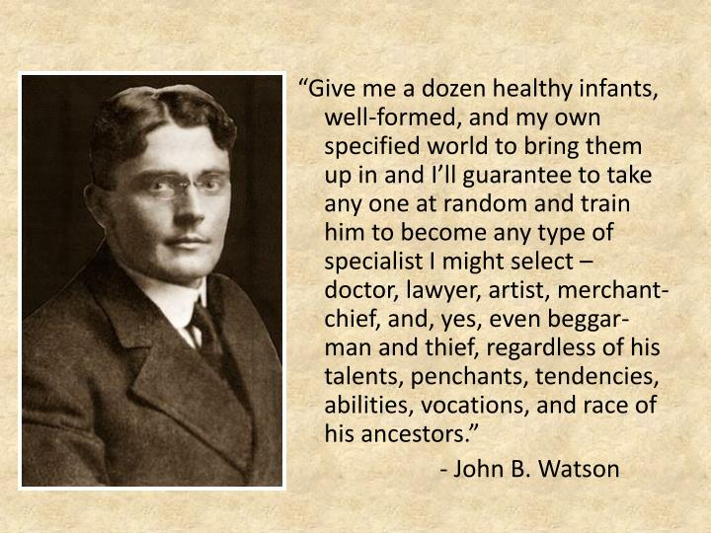

Slide 5
Language Acquisition
Language acquisition is the process by which humans acquire the capacity to perceive language, as well as to produce and use words and sentences to communicate.

Slide 6
Stages of child language acquisition

Slide 7
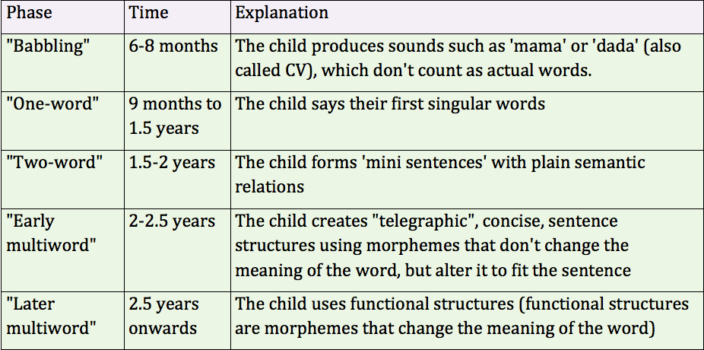

Slide 8
Theories of language acquisition
Innateness
Interactionism
Behaviourism

Slide 10
Behaviourism main beliefs
Behaviourists hypothesised that children learned their first language through stimulus, response, and reinforcement, postulating imitation and association as important processes.
Children start out as clean slates (tabula rasa) and language learning is the process of getting linguistic habits printed on these slates.

Slide 11
The quantity and quality of the language children hear, as well as the consistency of the reinforcement offered by others in the environment would shape the child's language behaviour.
Children imitate the language of their parents or caregivers. Successful attempts are rewarded because an adult who recognises a word spoken by a child will praise the child by giving it what it is asking for. Successful attempts are rewarded while unsuccessful ones are forgotten.

Slide 13
Chomsky’s criticism to behaviourism
Children seem unable to exactly imitate adult grammatical constructions, consider the following example, David McNeill (1933)
Child : Nobody don’t like me.
Mother :No, say no body likes me.
Child : Nobody don’t like me (eight repetitions of this sentence).
Mother : No, now listen carefully : say no body likes me.
Child : Oh ! No body don’t likes me

Slide 14
Over-generalisation (intelligent mistakes/ virtuous errors)
The vast majority of children go through the same stages of language acquisition.
There is evidence for critical period for language acquisition.
Language acquisition is more a matter of maturation than imitation.

Slide 15
Deaf children who have not been exposed to a language may make up their own language. These new languages resemble each other in sentence structure, even when they are created in different cultures.
The primary linguistic data which is the data children are exposed to while they are learning their native language will not be sufficient to cover all aspects of how sentences could be constructed,

Slide 16
and that humans, therefore, have some other form of aid in their process of acquiring their native language (poverty of stimulus).
Language is creative.
Creativity is not explicable if language is learnt just from the environment.

Slide 18
Language acquisition could only be accounted for by an innate, biological Language Acquisition Devise (LAD) or system

Slide 19
Limitations of the behaviourist view of language led in 1960’s to the alternative “generative” account of language.
Main Arguments:
Children must be born with an innate capacity for language development.
Children can acquire language in a relatively short period of time.

Slide 20
A child does not have to be formally taught to acquire language and reinforcement has a very small role in acquisition
Children discover the system of language from unsystematic and small amount of data.

Slide 21
The biological basis for the innateness position is the Critical Period Hypothesis (CPH). It is a specific and limited time period for the LAD to work successfully.
The CPH states that an individual must acquire a language by a critical period (before the age of 13) otherwise it will be difficult to acquire a language naturally. The main advantage to learning a language when younger is that the individual is able to acquire a native-like accent.

Slide 23
What do you think the limitations of nativism are?

Slide 24
“While the principle of grammar may indeed be acquired with little help from parents or other caretakers, adults are needed to help children build a rich vocabulary, master the rules of discourse” Gardner 1995

Slide 25
Limitations of Innateness Theory
Chomsky's work on language was theoretical. He was interested in grammar and much of his work consisted of complex explanation of grammatical rules. He did not study real children.
The theory relies on children being exposed to language but takes no account of the interaction between children and their caregivers
The case of the child JIM

Slide 26
Interactionist theory
Language Acquisition
Social factors/ nurture
Biological factors/ nature

Slide 27
Language develops as a result of the interplay between the child (human innate biological capabilities) and the social environment in which the child develops.
The interactionists recognise the existence of a powerful learning mechanism in the human brain, but they give much more importance to the environment then the innatists do.
Interactionists study the language mothers and other caregivers use when caring for young children, with special attention to modifications they make during these social interactions to assist children to communicate.

Slide 28
Caretakers speech is modified to suit the capacity of the child. This modified language is a crucial element in the language acquisition process.
Interactionists such as Jerome Bruner suggest that the language behaviour of adults when talking to children (child-directed speech CDS) is specifically adapted to support the acquisition process; this support is often described as scaffolding for the child's language learning.

Slide 29
Lev Vygotsky (1978): believed that language develops from social interaction. This social interaction leads to a higher level of knowledge and performance.
Exposure to impersonal sources of language such as television and radio alone is not sufficient for children to learn the structure of a particular language.

Slide 30
Limitations of the interactionist theory
While interactionists might say that innatists ignore language use, innatists might say that interactionists rely on language use too much.
Children in all cultures go through the same stages in acquiring their first language.
There are cultures in which adults do not adopt special ways of talking to children, so CDS may be useful but seems not to be essential

Slide 31
Thank you

